Slide 1
AI-Powered Adaptive Cybersecurity Threat Detection System
Final Executive Management Review Presentation
COMP-699B – Professional Seminar
Rivier University
Bhanuprakash Reddy Kamatam| December 07 2025

Slide 2
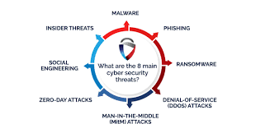
Problem Background
Cyberattacks such as ransomware and zero-day exploits are increasing.
Traditional IDS fail against evolving threats.
AI can learn dynamically to provide real-time protection.
(Saragih et al., 2025)

Slide 3
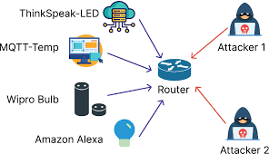
Research Motivation
AI-IDS models outperform traditional systems by 40%.
Explainable AI (XAI) adds interpretability.
Focus on trustworthy cybersecurity.
(Hassan et al., 2024; Al & Sağıroğlu, 2024)

Slide 4
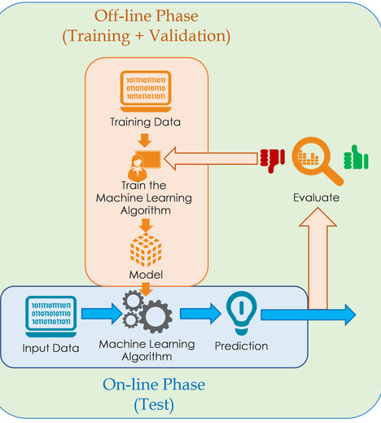
Project Objectives
1. Real-time detection and classification.
2. Explainable alerts for administrators.
3. Visual dashboard monitoring.
4. Reduce false positives and improve latency.
(Mohale & Obagbuwa, 2025)

Slide 5
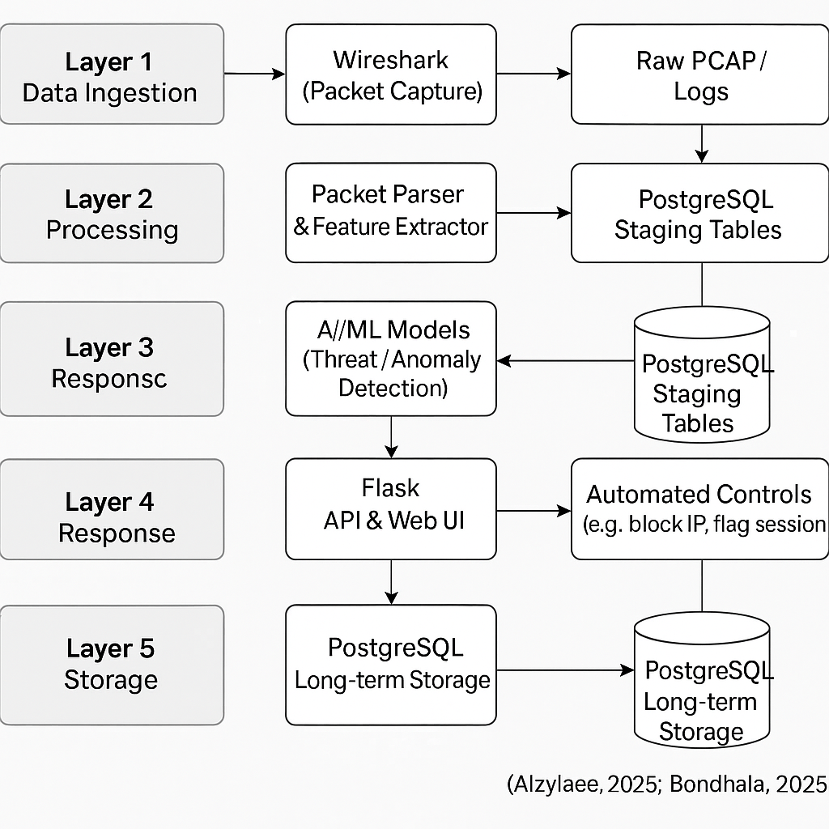
System Architecture
Layers:
1. Data Ingestion
2. Processing
3. AI Analysis
4. Response
5. Storage
Tools: Wireshark, Flask, PostgreSQL.
(Alzaylaee, 2025; Bondhala, 2025)

Slide 6
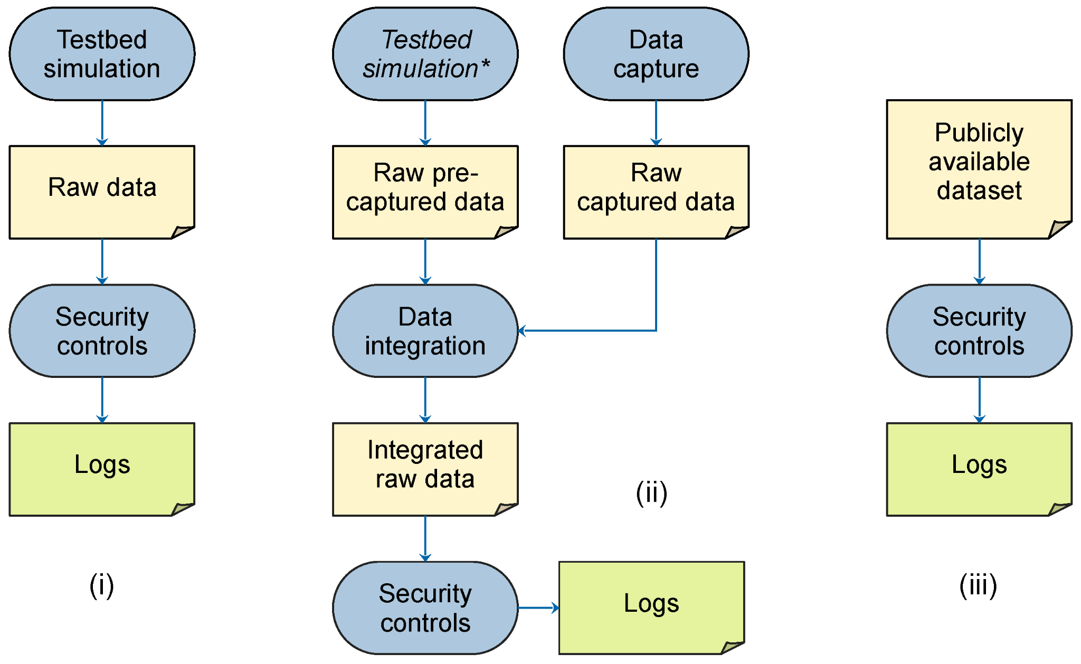
Functional Requirements
Detect and classify anomalies.
Log alerts securely.
Visualize alerts on dashboard.
Enable user feedback.
Retrain periodically.
(Mohale & Obagbuwa, 2025)

Slide 7
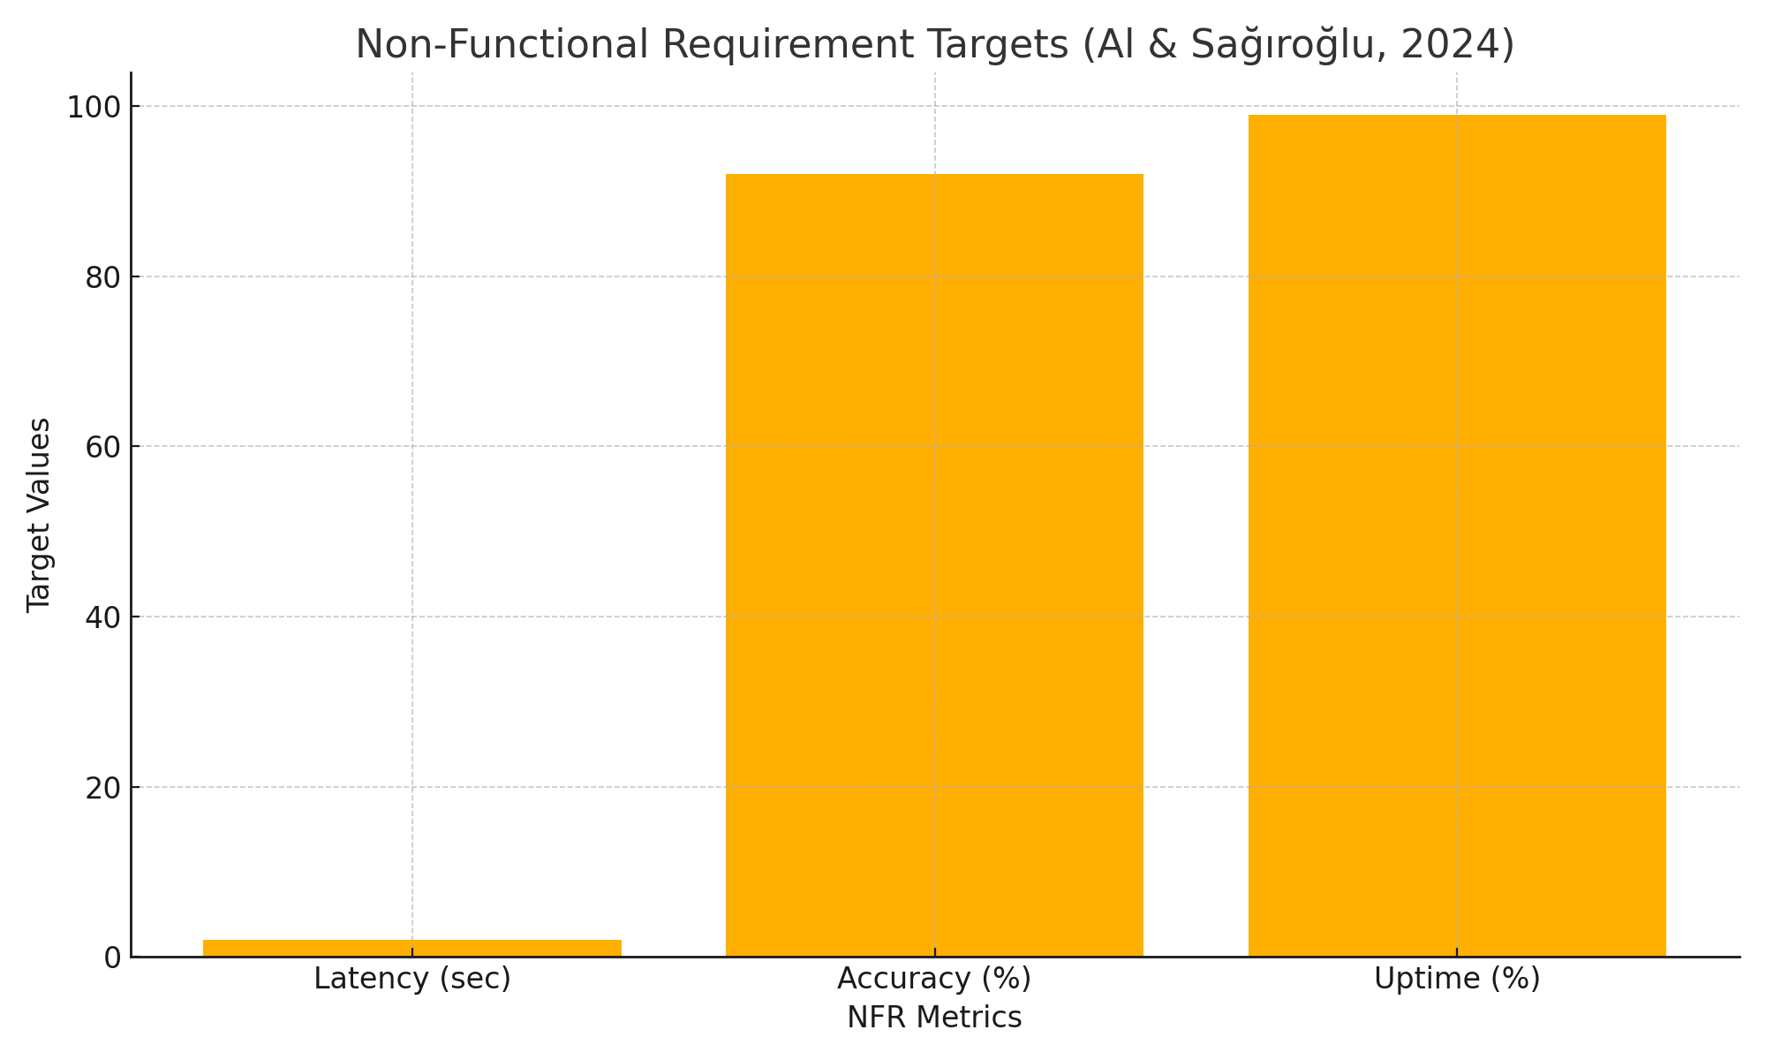
Non-Functional Requirements
Latency <2 sec | Accuracy >92% | Uptime 99% | AES-256 Encryption | Usable Interface | Explainable Alerts
(Al & Sağıroğlu, 2024)

Slide 8
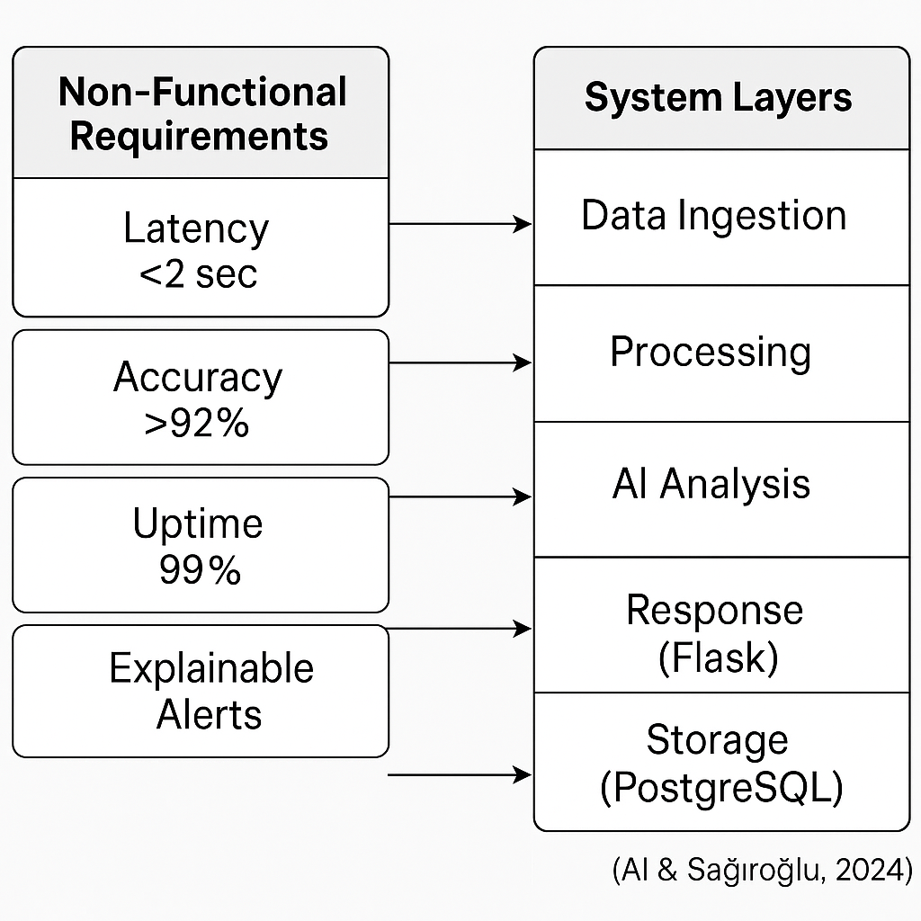
UML & Design Summary
Use Case: Admin interacts with AI Engine and Dashboard.
Class Diagram: MLModel, FeatureExtractor, AnomalyDetector.
Sequence Diagram: Capture → Detect → Alert → Dashboard.

Slide 9
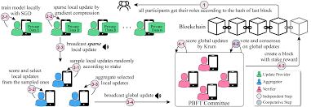
Key System Design Decisions
Hybrid ML-DL Model
Explainable AI
Blockchain Logging
Docker Deployment
Federated Learning
(Purandhar et al., 2025)

Slide 10
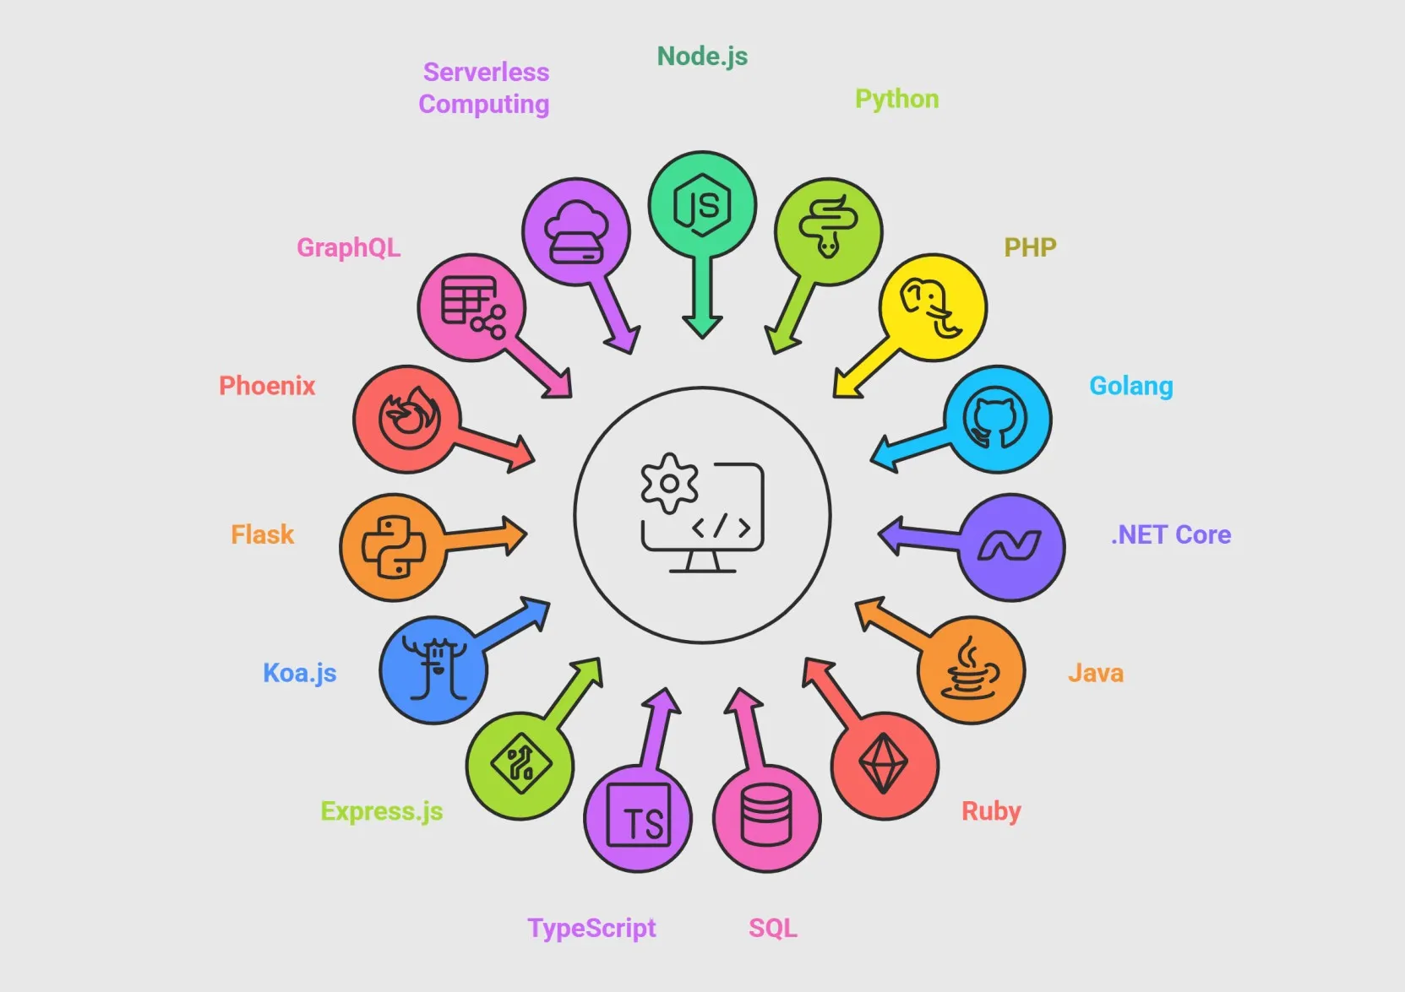
Implementation Overview
Backend: Python, TensorFlow, Flask
Frontend: React.js, Chart.js
DB: PostgreSQL
Testing: Wireshark, PyTest
Deployment: Docker, AWS EC2
(Bondhala, 2025)

Slide 11
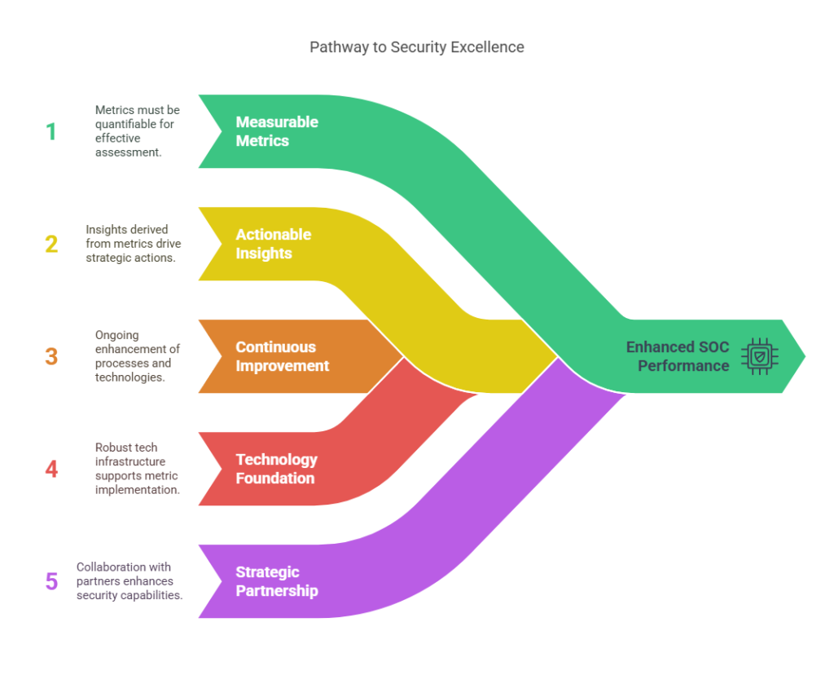
Live System Demonstration Summary
1. Dashboard visualizations.
2. Real-time alerts.
3. Classification confidence.
4. Admin feedback loop.
5. Encrypted logging.

Slide 12
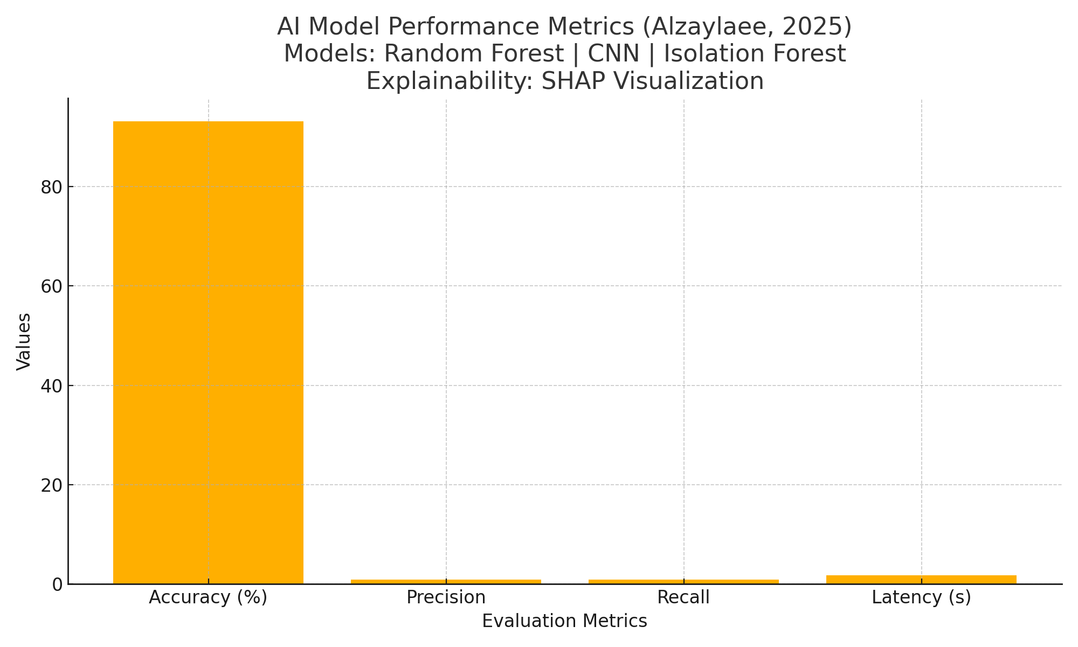
AI Model Performance
Accuracy: 93.2% | Precision: 0.91 | Recall: 0.90 | Latency: 1.8s
Models: Random Forest, CNN, Isolation Forest
Explainability: SHAP visualization
(Alzaylaee, 2025)

Slide 13
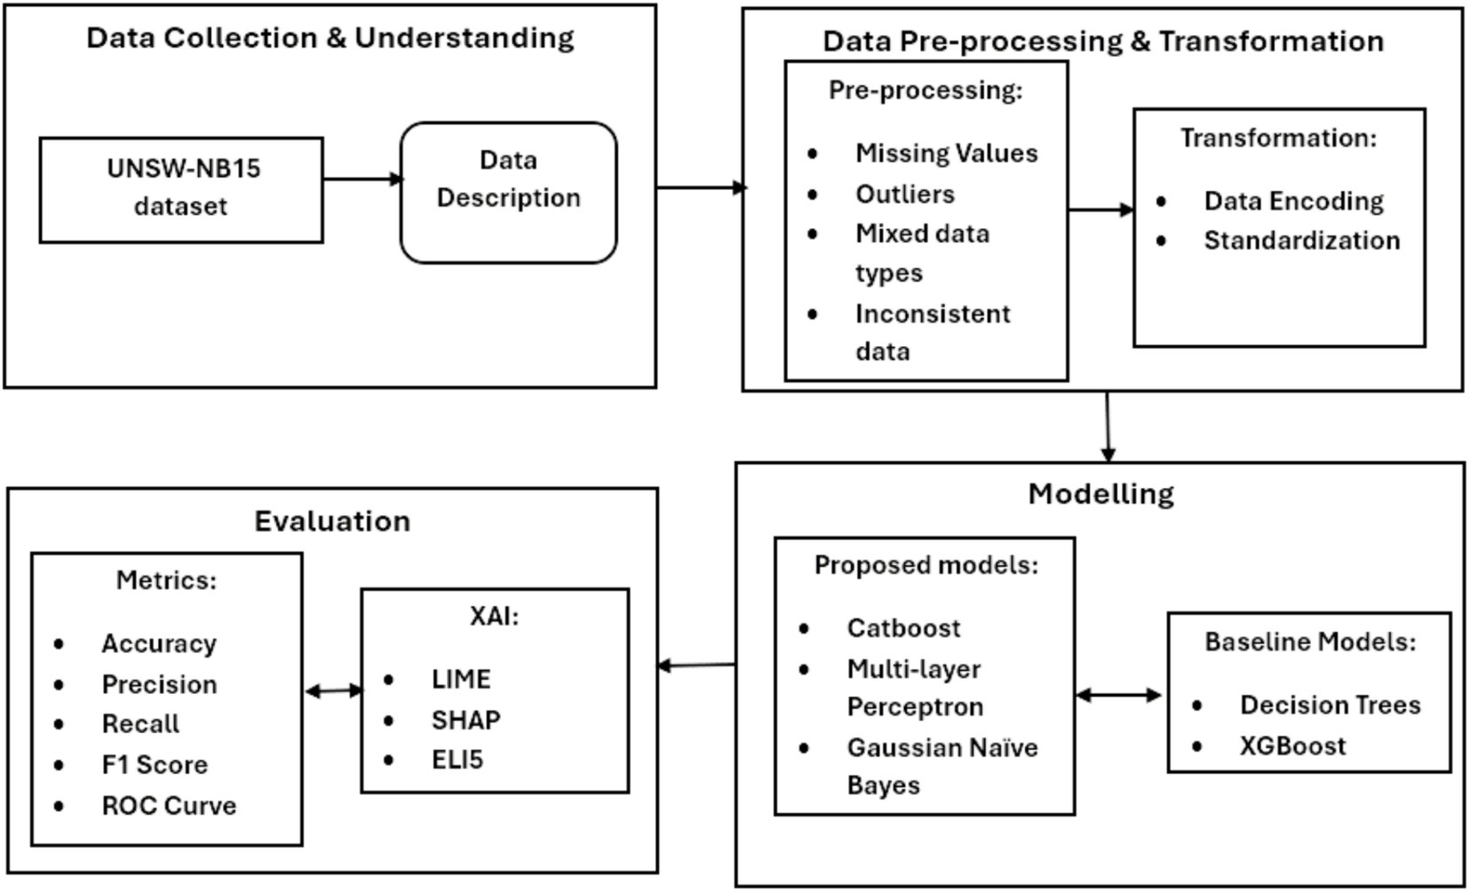
Explainable AI Demonstration
Example Alert: Abnormal login pattern detected.
Top factors: IP, frequency, timing anomalies.
(Mohale & Obagbuwa, 2025)

Slide 14
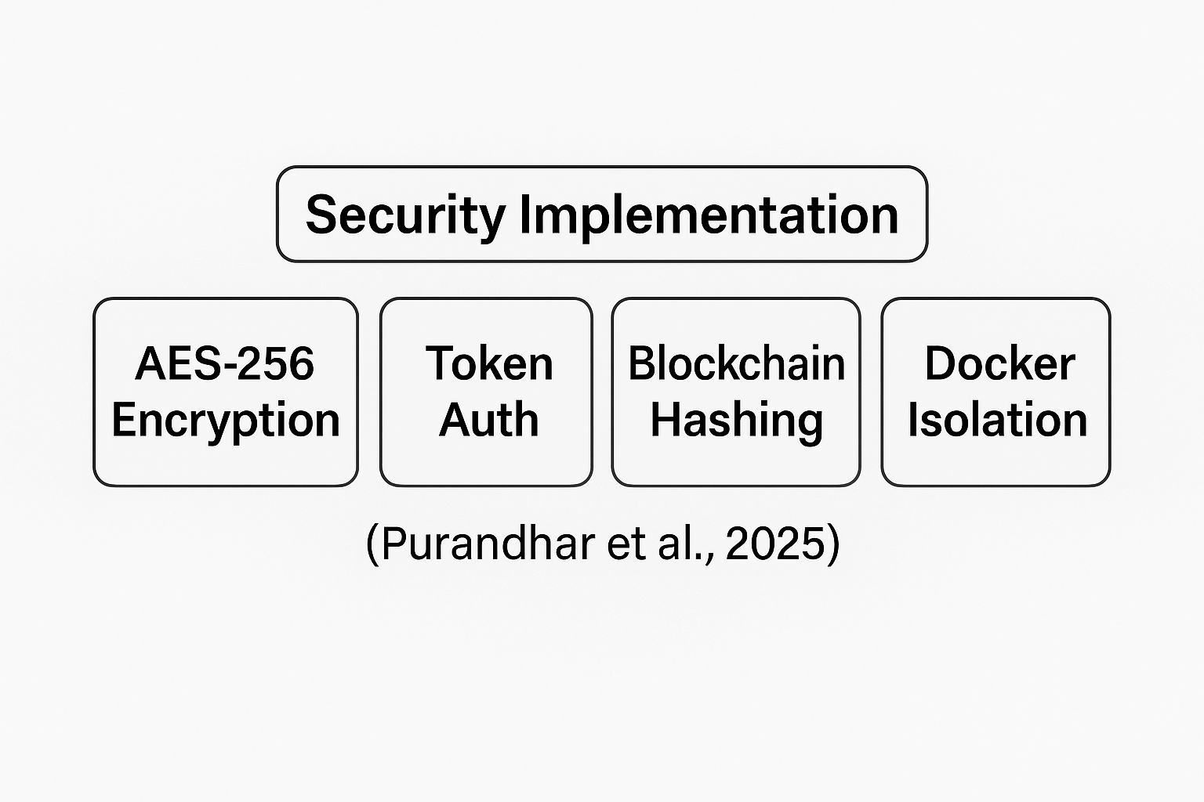
Security Implementation
AES-256 Encryption | Token Auth | Blockchain Hashing | Docker Isolation
(Purandhar et al., 2025)

Slide 15
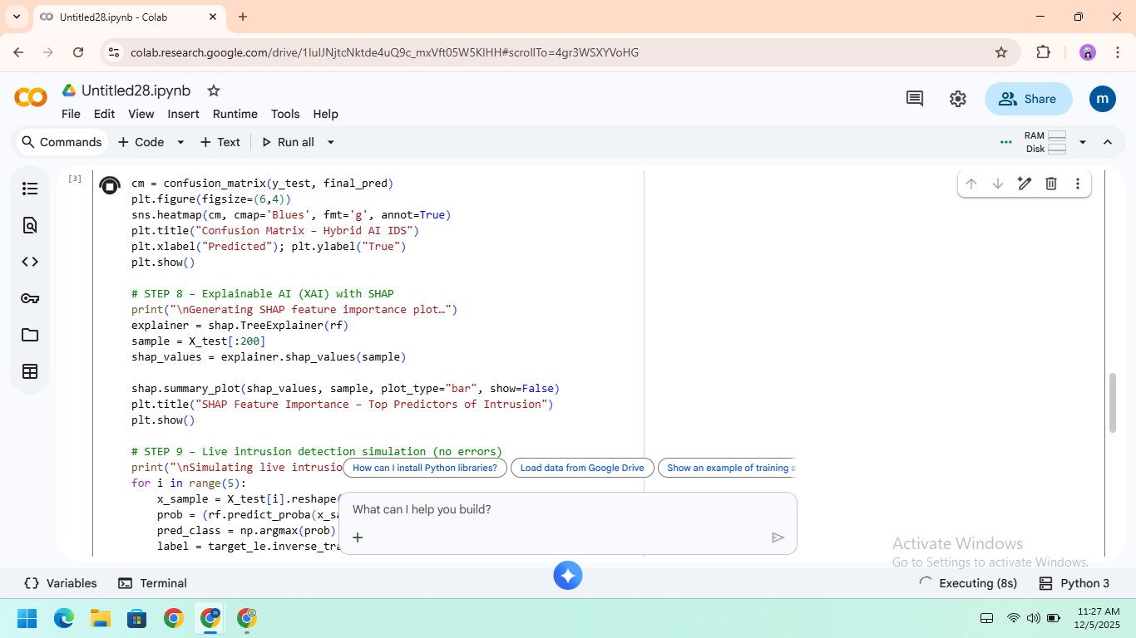
Code Walkthrough Introduction
Demonstrate code matching requirements and UML.
main classes, models, and dashboard integration.

Slide 16
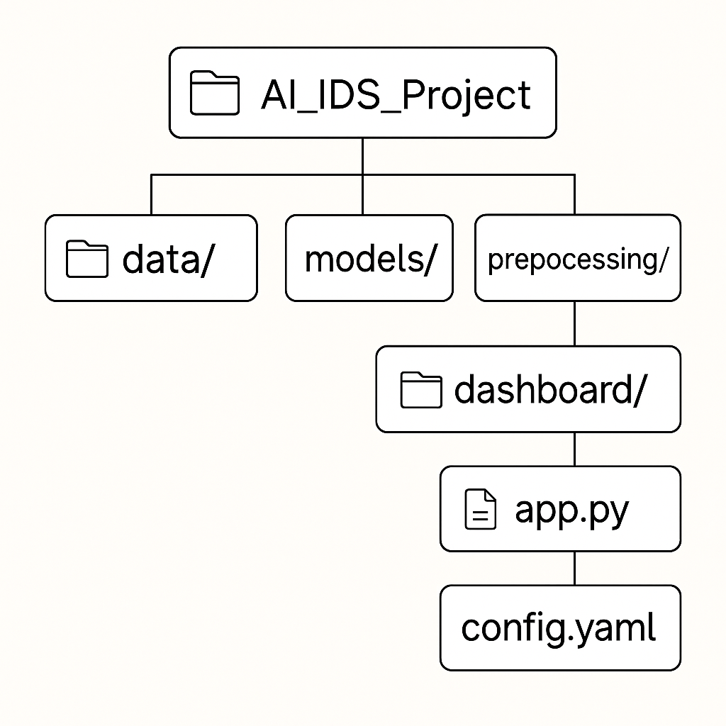
Folder Structure
/AI_IDS_Project
├── data/
├── models/
├── preprocessing/
├── dashboard/
├── app.py
├── config.yaml

Slide 17
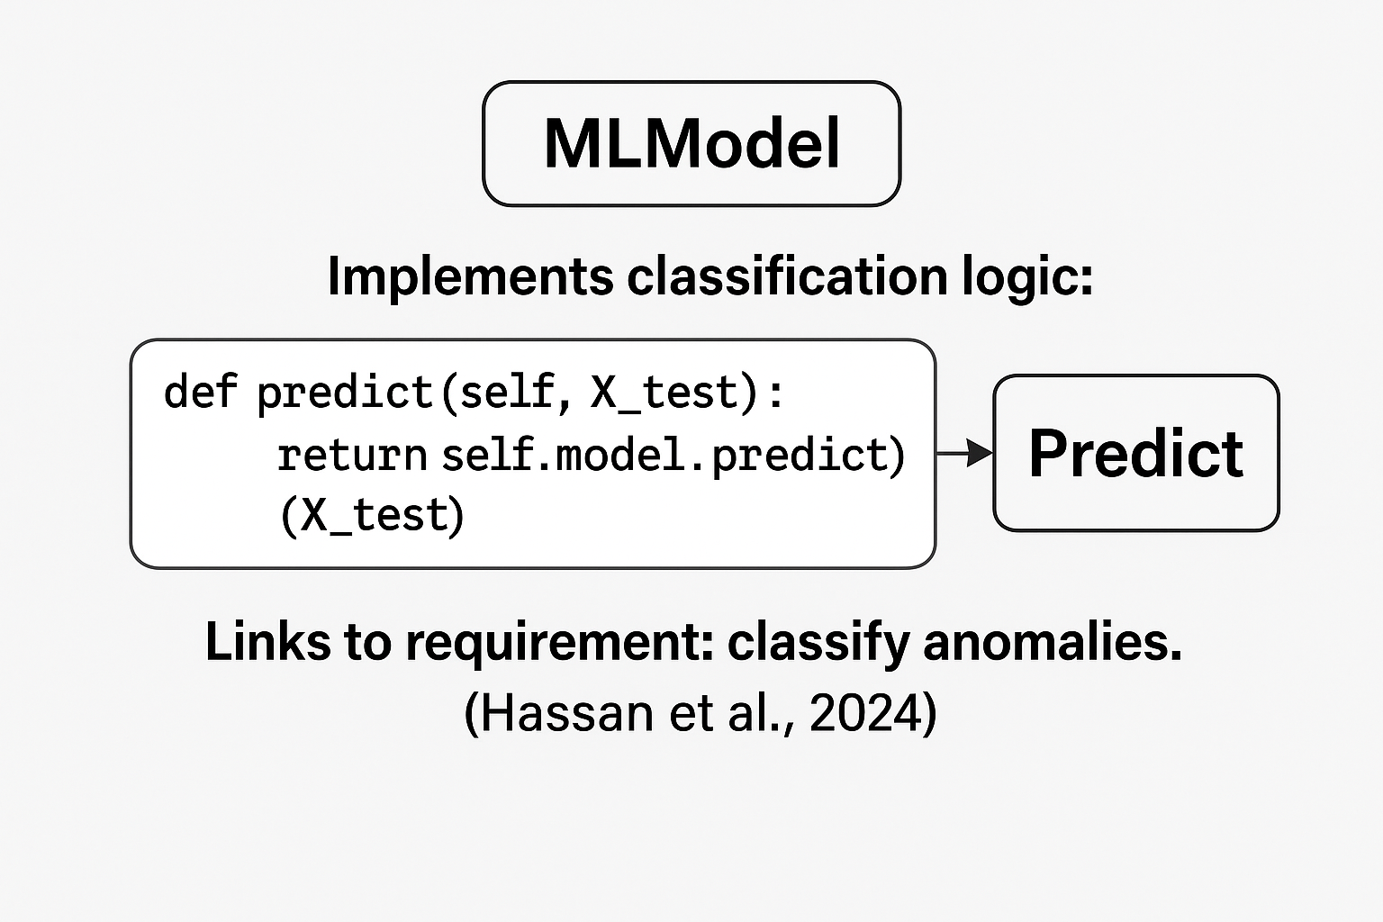
MLModel Class
Implements classification logic:
def predict(self, X_test):
return self.model.predict(X_test)
Links to requirement: classify anomalies.
(Hassan et al., 2024)

Slide 18
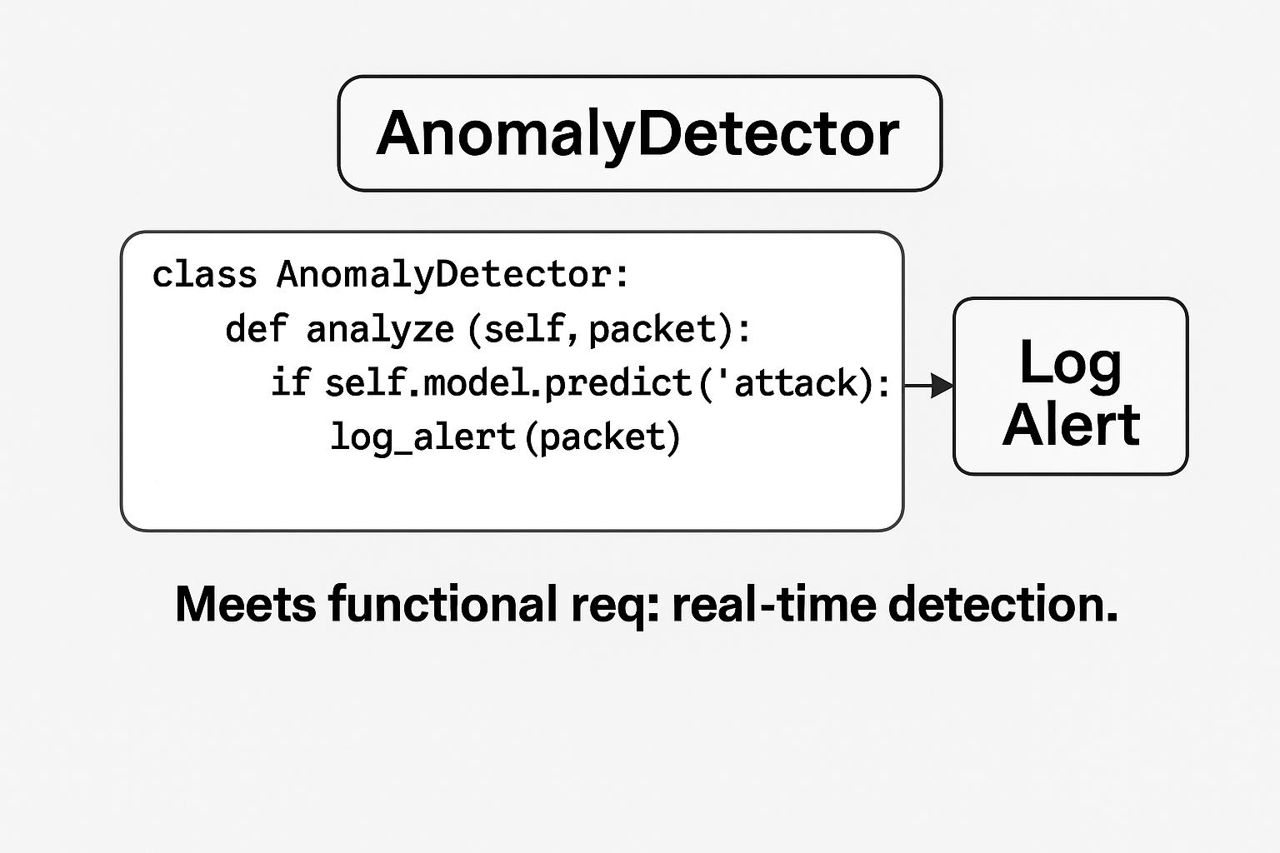
AnomalyDetector
class AnomalyDetector:
def analyze(self, packet):
if self.model.predict(packet)=='attack': log_alert(packet)
Meets functional req: real-time detection.

Slide 19
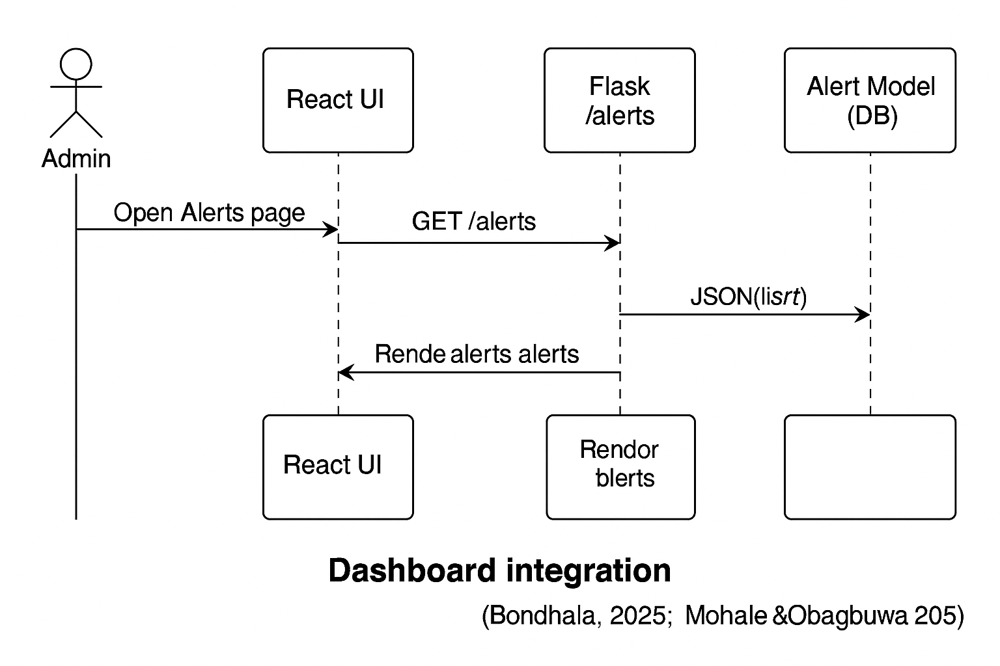
Dashboard Integration
@app.route('/alerts')
def get_alerts():
return jsonify(Alert.query.all())
Displays results on React UI.
(Bondhala, 2025; Mohale & Obagbuwa, 2025)

Slide 20
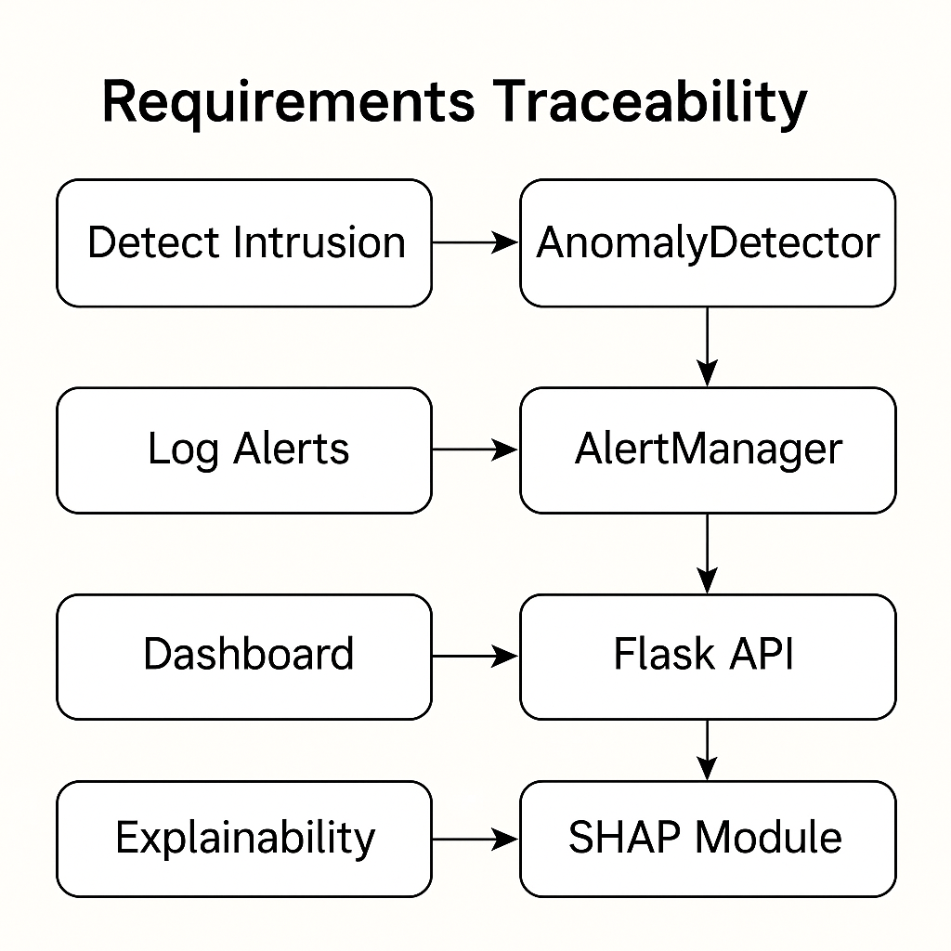
Requirements Traceability
Detect Intrusion → AnomalyDetector | Log Alerts → AlertManager | Dashboard → Flask API | Explainability → SHAP Module

Slide 21
Summary & Reflection
Project achieved: Real-time detection, explainability, scalability.
Future work: Blockchain & federated learning.
(Mohale & Obagbuwa, 2025; Al & Sağıroğlu, 2024)

Slide 22
References
Al, S., & Sağıroğlu, Ş. (2024). A review of explainable AI in IDS.
Alzaylaee, M. (2025). Enhancing cybersecurity through AI.
Bondhala, R. (2025). Cybersecurity in AI-driven data centers.
Hassan, Y. G. (2024). AI-driven intrusion detection.
Mohale, V. Z., & Obagbuwa, I. (2025). Systematic review on XAI IDS.
Purandhar, N. (2025). AI + Blockchain for CPS.
Saragih, H. (2025). IT professionals’ perspectives on AI IDS.

